Slide 1


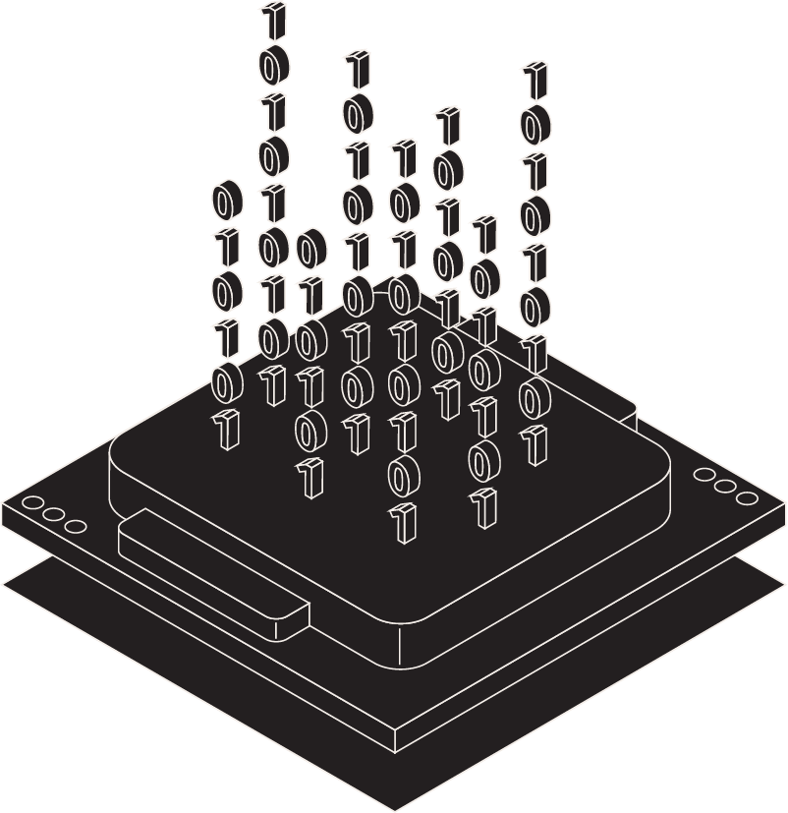
Flying Car
Valeria & Naomi

Slide 2
Overview
01
05
09
02
06
10
03 & 04
07
& 08
Title
Plan & Implementation
Summary
Overview
Pros
References
History
Cons

Slide 3
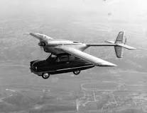
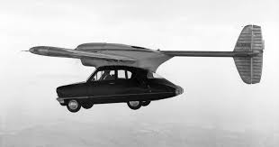
History
The idea started in 1903 with the Wright brothers taking their first flight with the airplane and the flying cars also started to become an idea as well. Aircraft designer Glenn Curtiss built his Autoplane in 1917. This work never flew out in the sky but it was able to make a few hops. 1937 was the next one called Arrowbile which was a three wheeled car and used the wings as storage but it didn't have the funds it needed to build it so it was never tested.
Notes:
“1917 Glenn Curtiss designed his aluminum Autoplane that sported three wings that spanned 40 feet (12.2 meters).ust a decade and a half after the Wright Brothers took off in their airplane over Kitty Hawk, N.C., in 1903, other people began chasing the dream of a flying car. There are nearly 80 patents on file at the United States Patent and Trademark Office for various kinds of flying cars. Some of these have actually flown. Most have not. And all have come up short of reaching the goal of the mass-produced flying car.” all from the second resource.

Slide 4
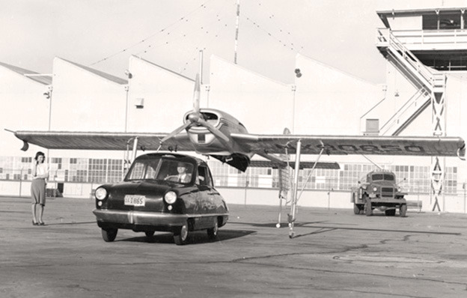
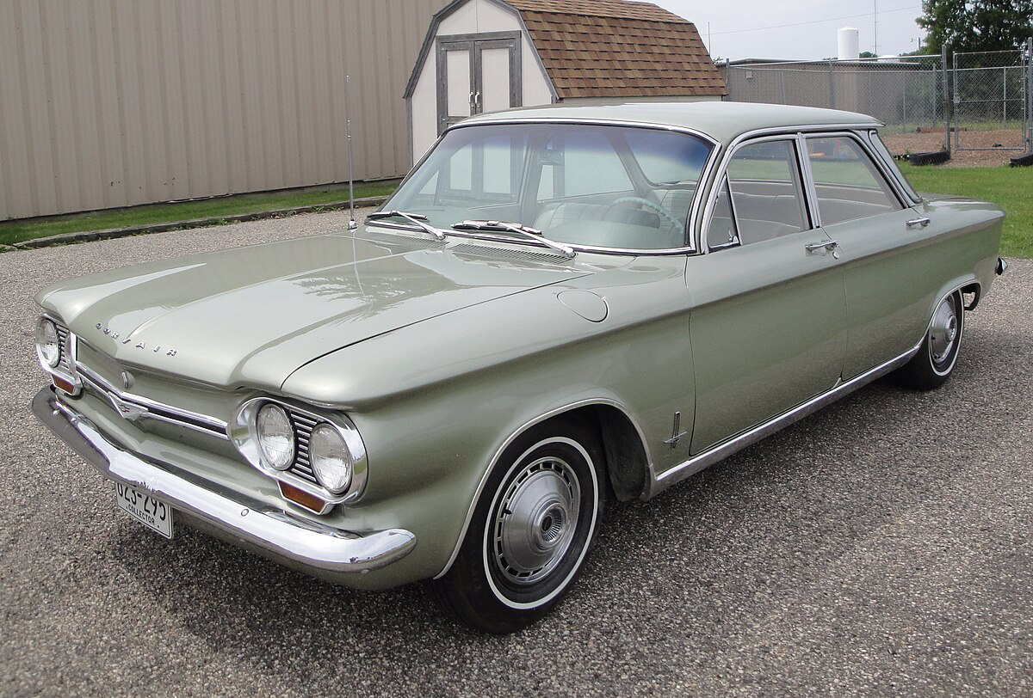
History PT2
Convaircar was an 1940’s and launched in 1946 it was a car with detachable airplane unit to it and it flew for an hour and 45 miles per gallon. On the third flight it crashed and they did not market the car anymore. Areocar was the most successful flying car that they had. It could drive then fly and drive again like nothing happen. This car had a fiberglass shield to protect it. It was the last car to get FAA approval. Ford Motor CO. was gonna market this but then the oil crisis had started.
Notes:
“Aerocar - Inspired by the Airphibian and Robert Fulton, whom he had met years before, Moulton "Molt" Taylor created perhaps the most well-known and most successful flying car to date. The Aerocar was designed to drive, fly and then drive again without interruption. Taylor covered his car with a fiberglass shell. A 10-foot-long (3-meter) drive shaft connected the engine to a pusher propeller. It cruised at 120 mph (193 kph) in the air and was the second and last roadable aircraft to receive FAA approval. FAA: Federal Aviation Administration (FAA) is the agency of the United States Department of Transportation responsible for the regulation and oversight of civil aviation within the U.S.” all from the second resource. These cars are some cars the worked the most very important to the history of flying cars.

Slide 5
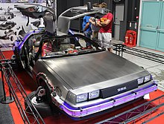
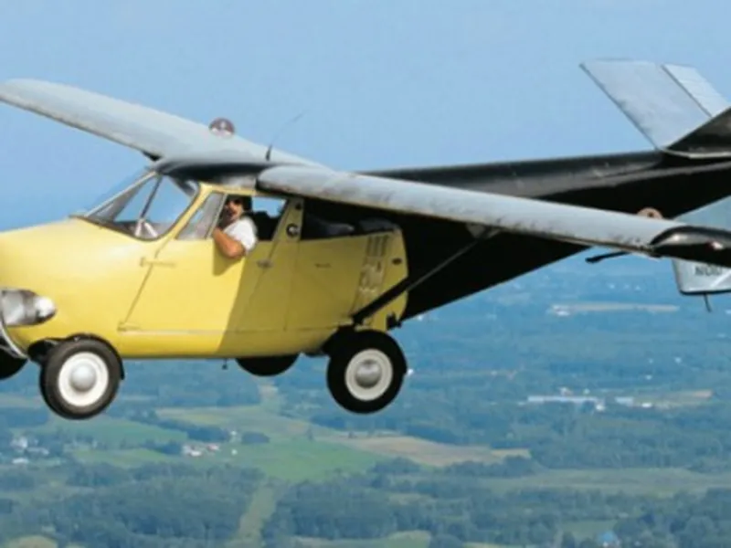
Plan & Implementation
Flying cars would impact many people across the globe. It would reduce travel time and will ease traffic on the road. It would pretty much eliminate distance all together. But if it become more common among everyone it can become substantially more threatening. It will also have an impact on climate change and will reduce carbon emissions It will also foster economic accessibility and development
Notes:
“The integration of flying cars into the transportation landscape holds the promise of transformative effects on urban mobility. One key advantage is the alleviation of traffic congestion. With the ability to travel in three dimensions, flying cars could circumvent ground-level traffic, offering a more time-efficient mode of transportation. Additionally, flying cars could enhance connectivity between urban and remote areas. Regions with challenging terrain or inadequate road infrastructure could benefit from the aerial capabilities of these vehicles, fostering economic development and accessibility. The concept of urban air mobility envisions a network of skyports facilitating the takeoff and landing of flying cars. These skyports, strategically located across cities, would serve as hubs for aerial transportation, enabling a seamless transition between ground and air travel. This infrastructure could redefine the urban landscape and create new opportunities for urban planning.” This pretty much just talks about on what it will have an impact on. You can find this on the last resource

Slide 6
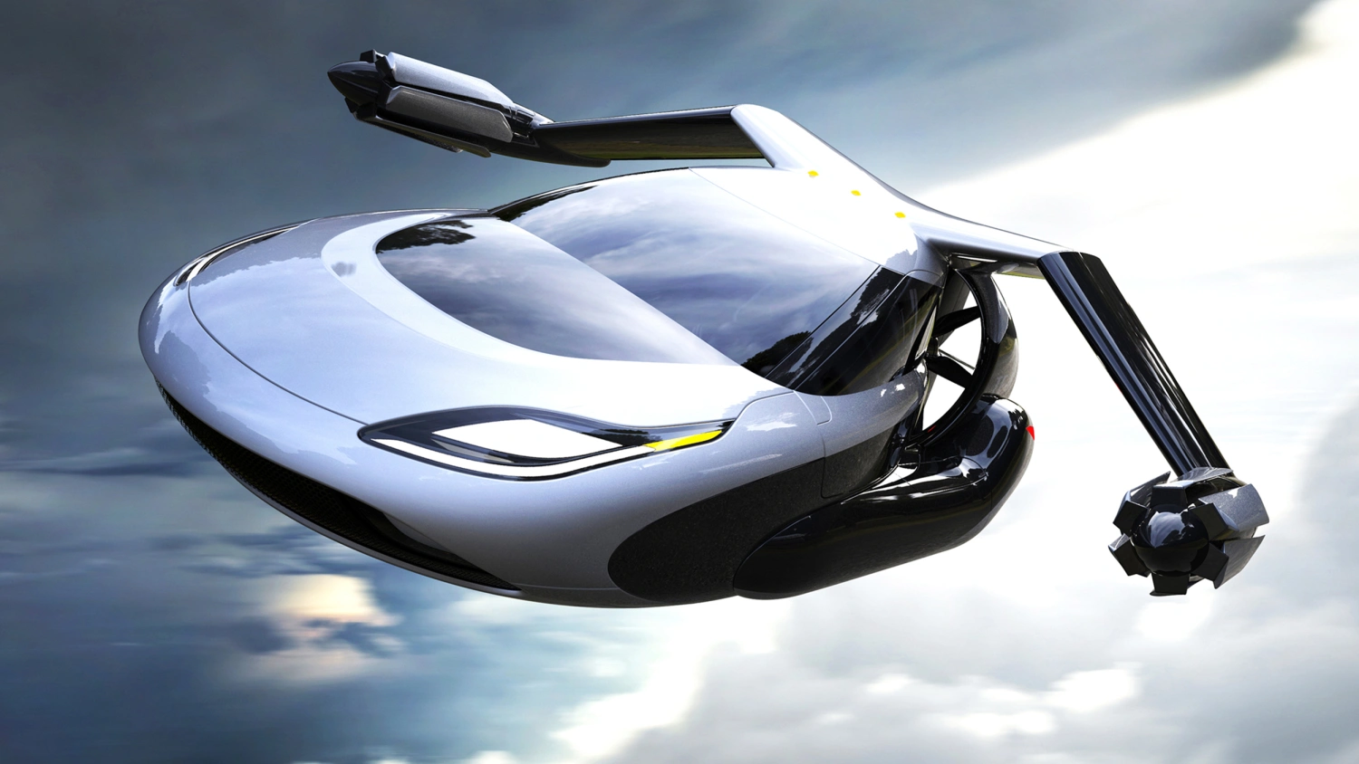
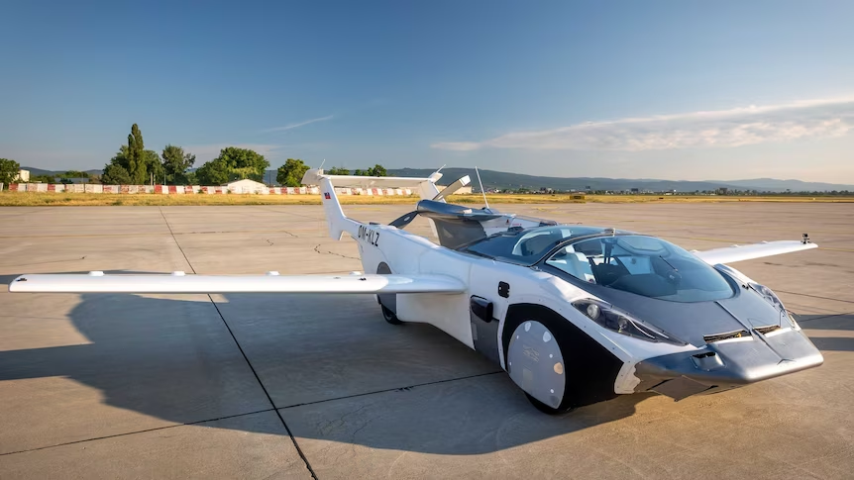
Pros
Not as manny traffic issues: There is always construction or other difficulties on the road but with flying cars there won’t be as many of these problems
Time saving: With flying cars it will reduce travel time and allow you to get to places faster and more efficiently
Less pollution: Zero emissions electric flying cars that also run on the ground reduce air pollution
Better Fuel Economy: Electric propulsion systems use less energy or fuels compared to traditional combustion engines.
Notes:
“Flying through the skies, no more headache of traffic jams and enjoying car rides as smooth as flights. Does it seem like a scene out of science fiction? It can be your reality in the coming future. The concept of flying cars or aeromobiles can turn this fictional scene into truth. In the 21st century, the development of flying cars is slowly taking a concrete form.
With the overuse of ground transportation, roads constantly being under construction, and extreme traffic on roadways, the transportation sector in India is no less than a nightmare to daily travellers. To tackle the situation, the Indian transportation field is currently going through a massive transformation. And real flying cars have marked the beginning of this transportation revolution.” This just explains all of the advantages that we could have and you can find this on the firsat source

Slide 7
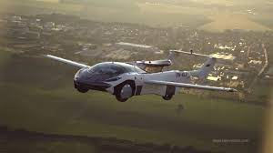
Cons/ Downside
Very expensive to build
Flying car crashes which could be very dangerous.
You would need a specialized license to be able to drive it around since it's so different in the air.
Notes:
“The development of flying cars brings along a multitude of challenges. Safety concerns hold the first position in the list of threats. Flying cars in real life must adhere to stringent aviation safety standards to reduce the risk of accidents in the skies and on the ground.” from the first resource. These would be the challenges the car faces when flying.

Slide 8
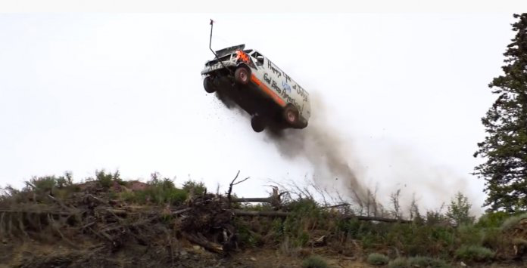
Cons (continued)
Fewer Safety Measures
Breakdowns cab mean falling out of the sky
Can be dangerous in bad weather
Noise issues or noise pollution

Slide 9
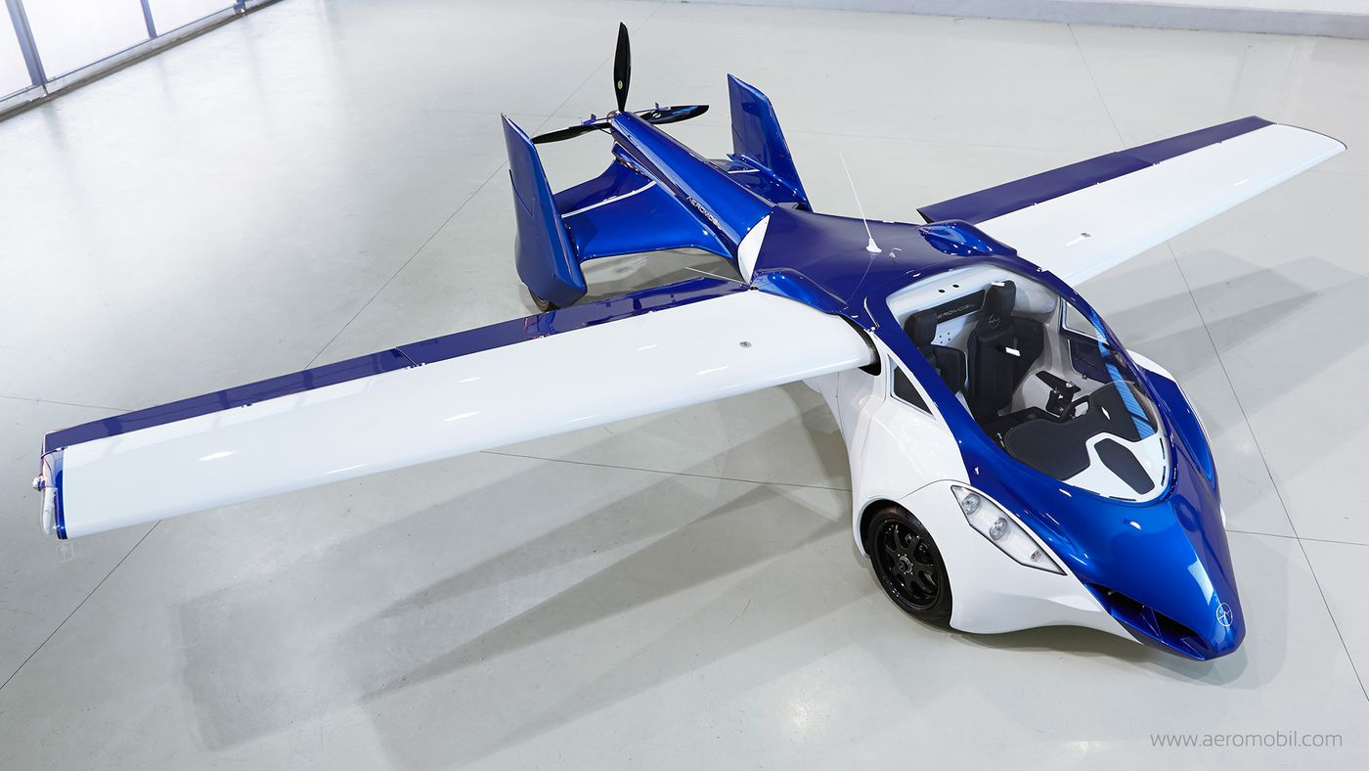
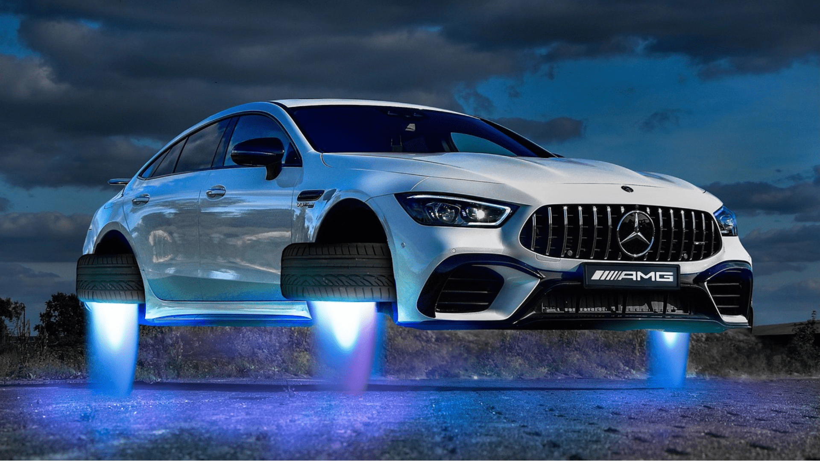
Summary
We would like to see flying cars in the future. It has so many benefits. But they have to be driven and sold to the right person. We like before purchasing one they would have to show they have a licence to drive in the sir or it could be very dangerous. On the other hand there are so many advantages we could get to better our society and environment all together.

Slide 10
References
Advanced future of transportation
How stuff works History of Flying cars
American progress: Flying Cars
How Flying cars will work
The advent of flying cars

